Slide 1
PiSCE
Project Findings
Third-i
6 April 2017

Slide 2
Outline
What is PiSCE?
Main PiSCE Deliverables
Why the need of a PiSCE?
Main findings of PiSCE
How does it fit into a bigger picture of self-care?
Notes:
(Pilot project on the promotion of self-care systems in the European Union)

Slide 3
PiSCE in a Nutshell
Objective:
The creation of a platform of experts in self-care and healthcare to put in place a framework for action to enhance self-care at EU level and develop strategies to support the broader implementation of effective self-care.
Notes:
(Pilot project on the promotion of self-care systems in the European Union)

Slide 4
What is PiSCE?
Pilot project on the promotion of self-care systems in the European Union
Self-care, self-management, patient empowerment, and the role of health care systems as central focus
5 pre-selected minor ailments
Athlete’s foot, Cold, Cough, Heartburn (without indigestion), Lower urinary tract infection (UTI)
Notes:
- 5 minor ailments: help Platform of Experts to recognize how widely applicable the advice and tools can be.

Slide 5
Main PiSCE Deliverables
Guideline on how to promote self-care within the EU taking into account the outcome of the cost benefit analysis of self-care systems (EAHC/2013/Health/ 26) in the EU and the study of transferability of best practices.
Guideline to help Member States and stakeholders to develop and produce communication tools on self-care.
Concrete proposals for policy actions and collaboration at EU level on self-care which will give an added value in supporting the broader implementation of effective self-care.
Notes:
- 5 minor ailments: help Platform of Experts to recognize how widely applicable the advice and tools can be.

Slide 6
Defining Self-Care
“The actions people take for themselves, their children and their families to prevent and care for minor ailments and long-term conditions and maintain health and well-being after an acute illness or discharge from hospital”
(UK, Department of Health 2005)
PiSCE definition of Self-Care
“A learned tool enabling people to maintain health and to cope with illness and disability.
Along with better health literacy it also supports optimal and timely use of available health services while avoiding a total dependency upon them for minor ailments”
(Source: PiSCE Report 2017).
Notes:
- 5 minor ailments: help Platform of Experts to recognize how widely applicable the advice and tools can be.

Slide 7
The PiSCE Platform of Experts
Alan Quirk, RCP Centre for Quality Improvement
Ales Bourek, Mazaryk University
Basia Kutryba, Qveritas
Bo Bergman, Chalmers University
Charan Nelander, DCHE
Corinna Antonia Hartrampf, AIM
Cristina Cabrita, BEUC
David Somekh, EHFF
Eline de Kok, V&VN
Gustavo Maranes AESGP
Herwig Ostermann, GÖG
Ian Banks, EMHF
Jacqueline Bowman, Third-i
Jacques de Haller, CPME
Jamie Wilkinson, PGEU
Jeroen Havers, Vilans
Jim Phillips, ENOPE
Kaisa Immonen-Charalambous, EPF
Kristina Zgodavova, TUKE
Kristine Sorensen, Global Health Literacy Academy
Maria Merce Rovira Regas, EIWH
Piera Poleti, CEREF
Rosa Suñol, FAD
Rotar Pavlic Danica, EFPC
W. (Wilma) Otten, TNO

Slide 8
Why the need for a “PiSCE”? Costs to health systems
“a sizable proportion of emergency hospital admissions could have been equally well addressed or better treated in a primary care setting or even managed by patients themselves, with appropriate education”
“Better information is key. Generating and publishing indicators (such as those on unnecessary or low-value care, overprescription of antibiotics, and delayed hospital discharges) is required to bring the scale of the problem to the attention of a wider public”
“Reducing wasteful clinical care presents the dual opportunities of improving both quality of health care and efficiency”
Choosing Wisely campaign: Bottom-up initiative that tries to “Promote conversations between clinicians and patients” by helping patients choose care that is supported by evidence, does not duplicate other tests or procedures patients have already received, is free from harm, and is truly necessary.
Reduce inappropriate care and harm; reduce costs to health care system
Source: OECD Report on Tackling Wasteful Spending on Health (2017)
Notes:
Choosing Wisely: started in USA, now has 10 countries adaptation.

Slide 9
The Danish experience
Problem:
9000 children (0-4 years) are unnecessarily admitted to hospitals four or more times
In the last 3-4 years there has been an increase of 20-30% of children who did not need to be admitted
Cost:
Unnecessary admissions to hospital system cost half a billion kr.
Reason:
Parents do not know what to do when a child has a fever
Source:: http://jyllands-posten.dk/indland/ECE9469517/bekymrede-foraeldre-flokkes-til-hospitaler/

Slide 10
Main Findings of PiSCE
Work Package 1: Guidelines for Promotion of Self-care
Work Package 2: Guidelines for Communication Tools
Work Package 3: Policy recommendations
Notes:
Good self-care can be applicable to a wide range of ailments. A wider and stronger investment within the EU towards self-care would have very significant impacts on the health and wellbeing of the citizens of the EU.

Slide 11
Guidelines for Promotion of Self-care
Results:
An extensive and elaborate body of work that can help at macro-, meso- and micro-level.
Basis for future guidelines on other minor ailments, in order to facilitate the production of guidelines.
Source: WP2 PiSCE Final Conference Presentation

Slide 12
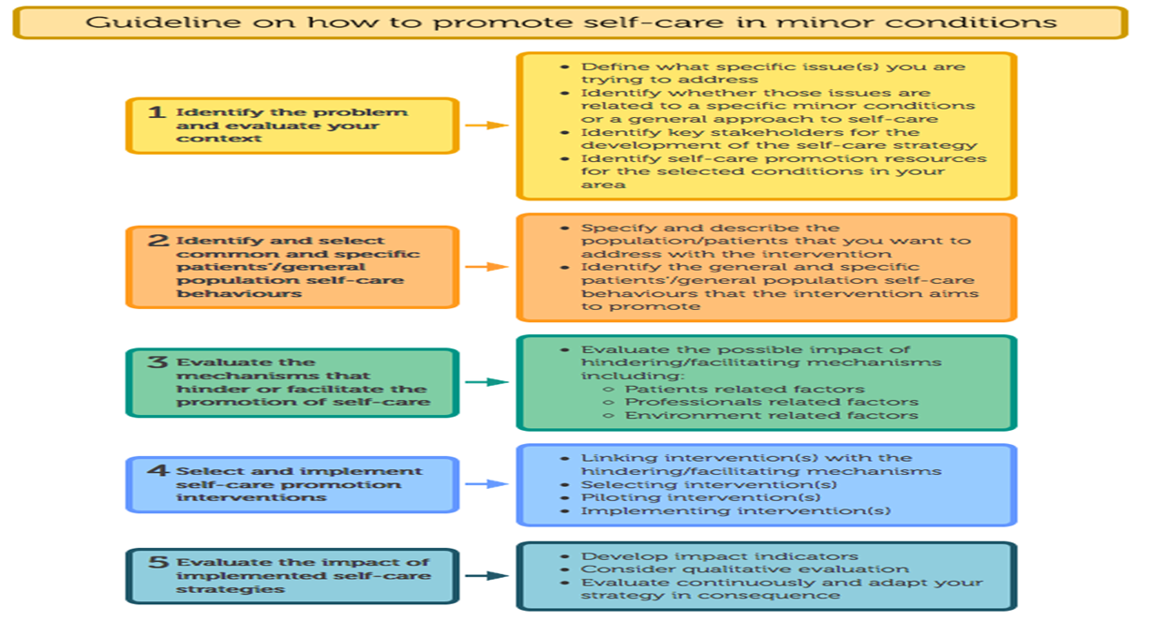
Guidelines for Promotion of Self-care
Source: WP1 PiSCE Final Conference Presentation

Slide 13
Guidelines for Promotion of Self-care
Conclusions:
Lack of systematic analysis of self-care promotion practices.
Compared with promotion of self-care in chronic conditions à different channels of reaching the population
As with chronic conditions à condition based approaches (specific health behaviours)
Source: WP1 PiSCE Final Conference Presentation

Slide 14
Guidelines for Communication Tools
Results:
Good communication for health care needs to consider underlying principles of involvement and needs of the target audiences.
Health care systems are used to evaluating medical procedures, yet there is no prioritisation of a structured evaluation of communication efforts.
Dissemination of good communication practices within health in Europe is difficult.
Source: WP2 PiSCE Final Conference Presentation

Slide 15
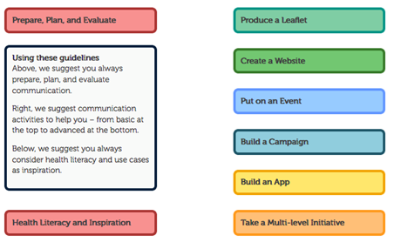
Guidelines for Communication Tools
Source: WP2 PiSCE Final Conference Presentation

Slide 16
Policy Recommendations
Results:
Recommendations that will modify the attitude towards health in Europe.
Higher engagement and empowerment of the citizen – allowing for not only better lives when experiencing minor ailments, but also creating a better basis for self-management when chronic conditions arise as well as having potential economic benefits.
This was reached by consensus.
The policy recommendations are therefore not only ambitious but also widely supported through the communities represented.
Source: WP3 PiSCE Final Conference Presentation

Slide 17
Policy Recommendations
Results:
Implementation
Establishing a framework that will encourage the exchange of best practices on self-care
Securing an engagement platform to support national and regional initiatives on self-care
Education
Inclusion of self-care in school education and life-long learning
Inclusion of skills to support self-care as part of curriculum in education and training of health professionals
Public Health
Integration of new technologies to support people’s self-care
Embedding self-care in health literacy initiatives
Source: WP3 PiSCE Final Conference Presentation

Slide 18
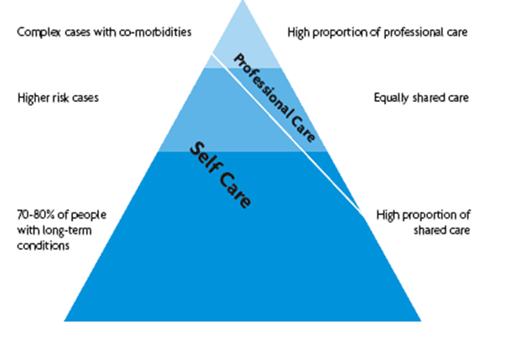
How does this fit into a bigger picture of self-care?
PiSCE set the stage for the implementation of self-care beyond these five minor conditions
The guidelines for promotion of self-care, the guidelines for Communication Tools, and the Policy recommendations have a wider application. They build a foundation for European cooperation on better communication strategies, sustainable and resilient healthcare systems, and empowered patients.
Source: Prof. Bert Vrijhof, PiSCE Final Conference presentation
Notes:
PiSCE set the stage for the implementation of self-care beyond these five minor conditions.
it was a tender and we need to show multi-stakehodler and multi-national participation

Slide 19
OECD study
Giving patients information on what is safe, effective and appropriate care: 24% patients with information on inappropriate use of proton pump inhibitors stopped or reduced their use.
Partnership for Patients initiative: patient, family, and community engagement: 17% reduction in number of hospital-acquired conditions.
Source: OECD Report on Tackling Wasteful Spending on Health (2017)
Notes:
Choosing Wisely: started in USA, now has 10 countries adaptation.
Denmark: Danish Society for Patient Safety
Patient handbook: empowered patients to ask questions about providers’ hand hygiene, questions on their health.

Slide 20
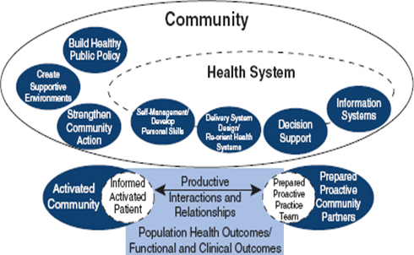
Future of self-care?
Bert Vrijhof: “In redesigning chronic care, self-care is the linking pin between the health system and the community”
“If Self-Care is not considered a building block for healthcare systems, then perhaps it is the mortar that keeps the blocks together”
How can we think about self-care within National Plans for health?
Source: Prof. Bert Vrijhof, PiSCE Final Conference presentation.
Notes:
Sustainable and holistic approach to patient and person centered care
Empowerment
Healthy living in schools
Supporting early actions
Tailoring care, taking account of class issues
Multi-stakeholder engagement
Person-centred integrated approach to wellbeing
Education as a driver
Long-term investment in prevention
Spanning National and EU levels
Social movement approach

Slide 21
Questions?

Slide 22
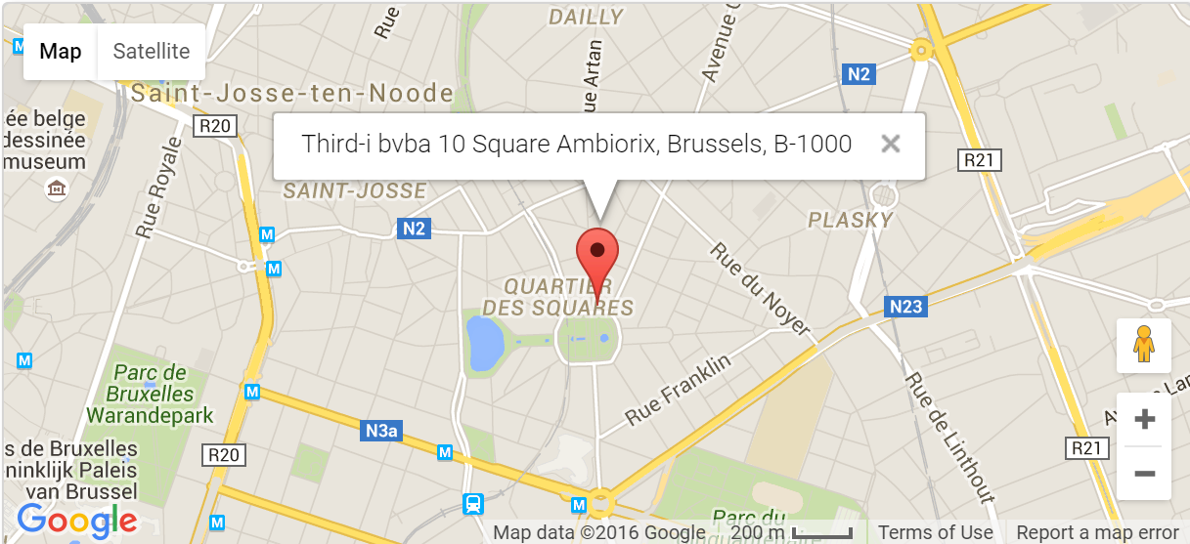
Contact Us
Third-i bvba
10 Square Ambiorix
B-1000 Brussels
Tel: +32 (0)2 880 06 17
Email: engage@third-i.eu Website: www.third-i.eu

