Slide 1
Break-out Session: Potential for a Danish self-care strategy?
Third-i
6 April 2017

Slide 2
Welcome!
Notes:
(Pilot project on the promotion of self-care systems in the European Union)

Slide 3
Session Objectives
Explore if there is a future for a nationally harmonised self-care strategy for Denmark?
What role can the hygiene community play in making this a reality?

Slide 4
Ageing and the healthcare system
An increasing number of people are living longer and at the same time are living with one or more long-term condition and/or with minor or self-limiting conditions
(Joint Aging Report EC, 2012).
At the same time, the healthcare workforce will shrink in most European countries by 10% as a result of demographic developments between 2007 and 2025.
Moreover, health problems and disease leads to loss of participation and labour productivity.
Notes:
Denmark:
WHO healthy aging strategy report 2012
Older people: one or more chronic diseases
80+ group expands: rise in demand for health care is felt
2007: public and private expenditure on long-term care was 2.5% of GDP, half of which is spent on home care.
Challenge: develop an adequate and coordinated package of long-term care that includes increased support for informal care at home
This is where self-care and hygiene comes in.
http://www.euro.who.int/__data/assets/pdf_file/0004/161797/Denmark-Healthy-Aging-Strategy-Final-July-2012.pdf

Slide 5
Defining Self-Care
“The actions people take for themselves, their children and their families to prevent and care for minor ailments and long-term conditions and maintain health and well-being after an acute illness or discharge from hospital”
(UK, Department of Health 2005)
PiSCE definition of Self-Care
“A learned tool enabling people to maintain health and to cope with illness and disability.
Along with better health literacy it also supports optimal and timely use of available health services while avoiding a total dependency upon them for minor ailments”
(Source: PiSCE Report 2017).

Slide 6
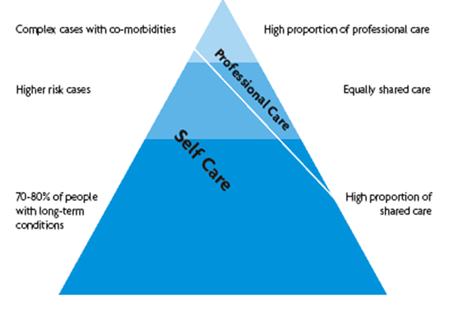
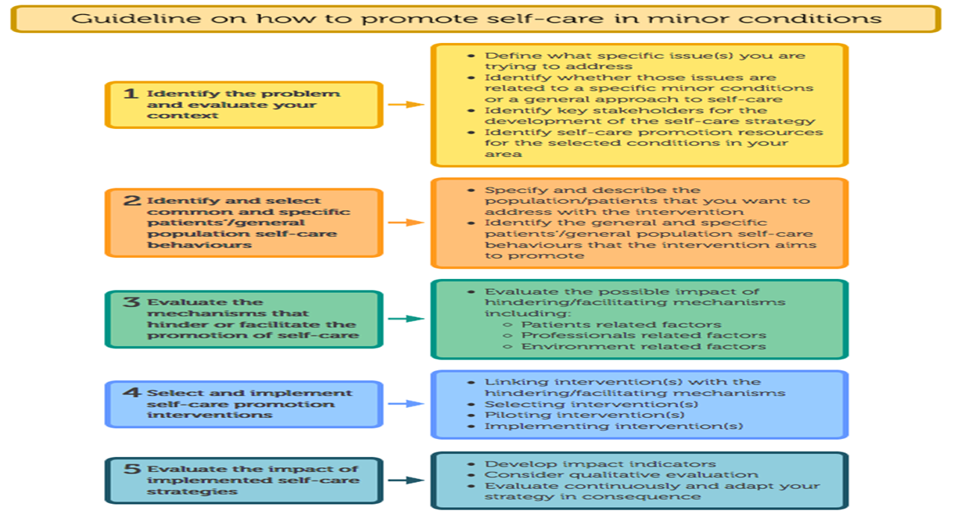
Structured approach to buiding a national strategy
Source: Prof. Bert Vrijhof, PiSCE Final Conference presentation
Notes:
PiSCE set the stage for the implementation of self-care beyond these five minor conditions.
it was a tender and we need to show multi-stakehodler and multi-national participation

Slide 7
Exercise 1
Which groups in Denmark would benefit from a “nationally harmonised approach to self-care”?
(5 minutes)

Slide 8
Exercise 2
Who needs to be involved and at which levels?
Notes:
Micro-level input important for national level, particularly in Denmark

Slide 9
Exercise 2
5 minutes
Write down as many types of stakeholders you think could/ should be involved in implementing a harmonised strategy on self-care in Denmark
10 minutes discussion
Clustering and prioritising stakeholders
Notes:
Micro-level input important for national level, particularly in Denmark

Slide 10
Exercise 3
What would be the main objectives and timelines for putting your ideal system into place?
Notes:
Think about
your target groups
what training would be necessary to

Slide 11
Conclusions
Main stakeholders: Anyone impacting on the patient journey in the hospital as well as in the community (teachers, employers, pharmacists, dentists, meeicl practitioners, specialist nurses ….)
Main objectives: Build on current national strategies (but non-diseases specific) to ensure non-aggravation (older people) and no-development (younger people) of chronic conditions
Timelines : 3 years
Deliverables :
Taking the national “cookbook” on hygiene and use as inspiration for self-care.
Education programmes and communication programmes for all actors in the patient centric pathway
Looking at example of dentists on how to teach the population to self-care
Explore competence levels within municipalities and ability to teach as well as share knowledge across stakeholder groups

Slide 12
Questions?

Slide 13
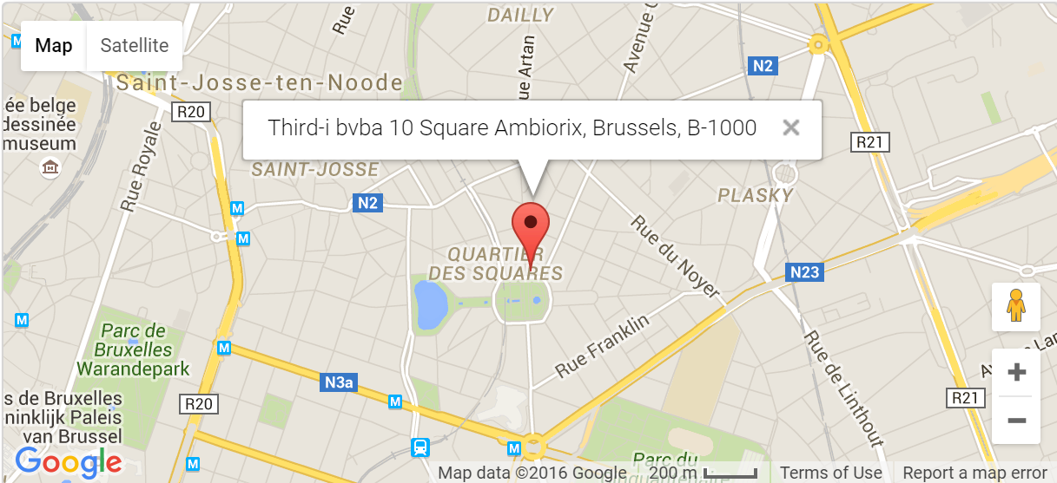
Contact Us
Third-i bvba
10 Square Ambiorix
B-1000 Brussels
Tel: +32 (0)2 880 06 17
Email: engage@third-i.eu Website: www.third-i.eu

