Slide 1
Hygiene Policies and Implementation
Ana Paula Coutinho Rehse
Division of Health Emergencies & Communicable Diseases
WHO Regional Office for Europe
Strategisk hygiejne - en investering, Rådet for Bedre Hygiejne - 12 September 2017.

Slide 2
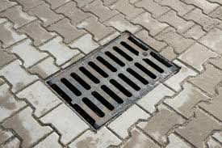
Idea!

Slide 3
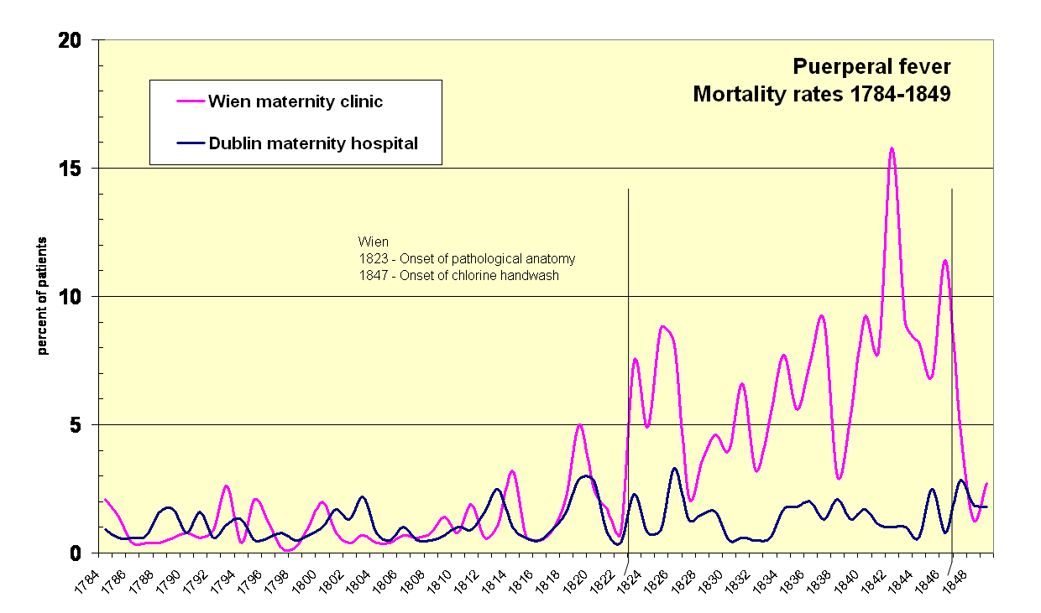
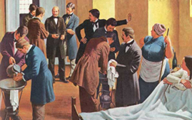
Ignaz Philipp Semmelweis

Slide 4
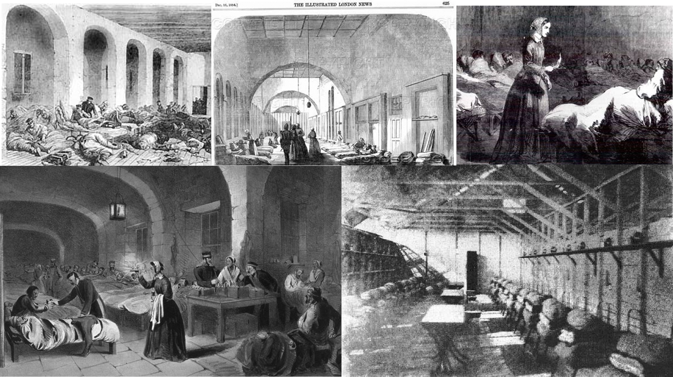
Florence Nightingale

Slide 5
While we all agree that hygiene is important, improving it becomes difficult if we cannot agree on what it means or understand where it comes from.

Slide 6
Hygiene
Hygiene refers to conditions and practices that help to maintain health and prevent the spread of diseases.
World Health Organization
Google trends – Hygiene September 2107
Notes:
Medical hygiene therefore includes a specific set of practices associated with this preservation of health, for example environmental cleaning, sterilization of equipment, hand hygiene, water and sanitation and safe disposal of medical waste.

Slide 7
Water, sanitation and hygiene in the European region
In the WHO European Region, 14 diarrhea deaths a day are estimated attributable to inadequate water, sanitation and hygiene.
More than 62 million people lack access to adequate sanitation facilities in terms of functioning toilets and safe means to dispose of human feces.
About 14 million people do not enjoy access to basic drinking-water source, and 62 million people do not have access to piped water on premises.
WHO Regional Office for Europe

Slide 8
Water, sanitation and hygiene in schools in the pan-European region
Most countries have standards in place, but these are diverse and often neglect critical WASH aspects.
Policies and targets are set, confirming countries’ commitment and reflecting priorities, but full implementation and improvement of WASH in schools is impeded.
The situation of water, sanitation and hygiene in schools in the pan-European region. 2016 WHO Regional Office for Europe

Slide 9
Burden of Healthcare Associated Infections (HAI)
On average at any given time 7% of patients will acquire at least one HAI. Death from HAI occurs in about 10% of affected patients;
Europe: more than 4 million patients are affected by approximately 4.5 million episodes of HAI annually, leading to 16 million extra days of hospital stay, 37 000 attributable deaths and contributing to an additional 110 000;
USA it was estimated that around 1.7 million patients are affected by HAI each year, representing a prevalence of 4.5% and accounting for 99 000 deaths.
Report on the endemic burden of healthcare-associated infection worldwide. Geneva: World Health Organization; 2011

Slide 10
Organization of infection control in European hospitals
Almost all hospitals (96%) had defined IC objectives, which mainly addressed hand hygiene (87%), healthcare-associated infection reduction (84%), and antibiotic stewardship (66%).
Great variance in IC staffing and policies across Europe.
Some areas of practice, such as hand hygiene, seem to receive considerably more attention than others that are equally important, such as antibiotic stewardship.
Strengthening of IC policies in European hospitals should be a public health priority.
J Hosp Infect. 2015 Dec;91(4):338-45.

Slide 11
Hygiene &
Sustainable Development Knowledge platform
https://sustainabledevelopment.un.org/

Slide 12
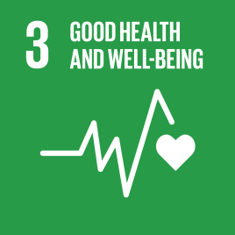
Goal 3: Ensure healthy lives and promote well-being for all at all ages
Addresses all major health priorities, including reproductive, maternal and child health; communicable, non-communicable and environmental diseases; universal health coverage; and access for all to safe, effective, quality and affordable medicines and vaccines.
It also calls for more research and development, increased health financing, and strengthened capacity of all countries in health risk reduction and management.
Sustainable Development Knowledge platform
https://sustainabledevelopment.un.org/

Slide 13
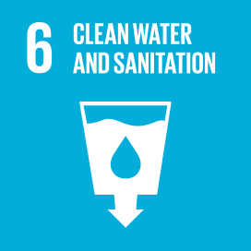
Goal 6: Ensure access to water and sanitation for all
Water and sanitation are at the very core of sustainable development, critical to the survival of people and the planet.
Goal 6 not only addresses the issues relating to drinking water, sanitation and hygiene, but also the quality and sustainability of water resources worldwide
Sustainable Development Knowledge platform
https://sustainabledevelopment.un.org/

Slide 14
Protocol on Water and Health
The Protocol on Water and Health to the 1992 Convention on the Protection and Use of Transboundary Watercourses and International Lakes is the first and only international legal agreement linking sustainable water management and the prevention, control and reduction of water-related diseases in Europe.
Secretariat: WHO/Europe and the United Nations Economic Commission for Europe (UNECE)
WHO Regional Office for Europe
Notes:
By adopting the Protocol, countries agree to take all appropriate measures to:
ensure adequate supplies of wholesome drinking-water;
secure adequate sanitation of a standard that sufficiently protects human health and the environment;
protect water resources used as sources of drinking-water, and their related water ecosystems, from pollution;
provide adequate safeguards for human health against water-related diseases;
establish and maintain effective national and local surveillance and early warning systems for monitoring and responding to outbreaks or incidents of water-related diseases.

Slide 15
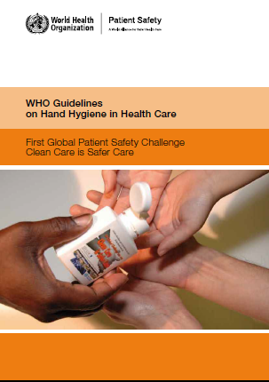
World Alliance for Patient Safety Clean Care is Safer Care
Focus on preventing infection associated with health care.
Core message simple measures save lives.
WHO guidelines om Hand Hygiene in Health Care
SAVE LIVES: Clean Your Hands 5 May 2017 - Fight antibiotic resistance - it's in your hands
World Health Organization

Slide 16
Too many of the most vulnerable people seeking care develop a health care associated infection resulting in harm and sometimes even death. This could be prevented through simple, low-cost IPC interventions performed at critical moments, such as hand hygiene.

Slide 17
Absence of hand hygiene at key moments is one aspect of IPC that is considered to be a critical example of defects in the quality of care, usually compounded by weak infrastructures and the lack of access to affordable products, thus putting patients, health workers and the wider population at risk

Slide 18
Hygiene & People at the centre
Reduce inequalities
Efficient use of societal resources (intersectoral actions consistent, whole of-society and whole-of-government)
Respond to the diverse needs of all people, paying particular attention to the values of solidarity and equity.
Transparency and a renewed commitment

Slide 19
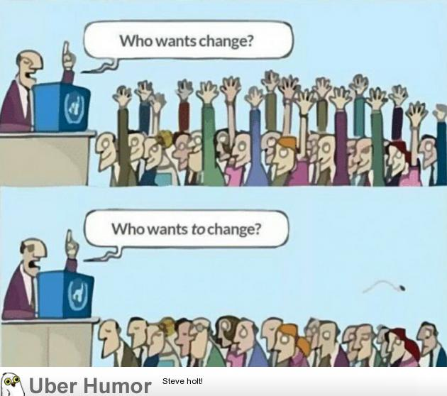
Hand Hygiene and Behavior change
Knowledge, attitudes, beliefs and personality traits
influences behavior
Intrapersonal (individual), interpersonal, institutional and community
WHO Guidelines on Hand Hygiene in Health Care: First Global Patient Safety Challenge Clean Care Is Safer Care.

Slide 20
Thank you for your attention!

